Slide 1

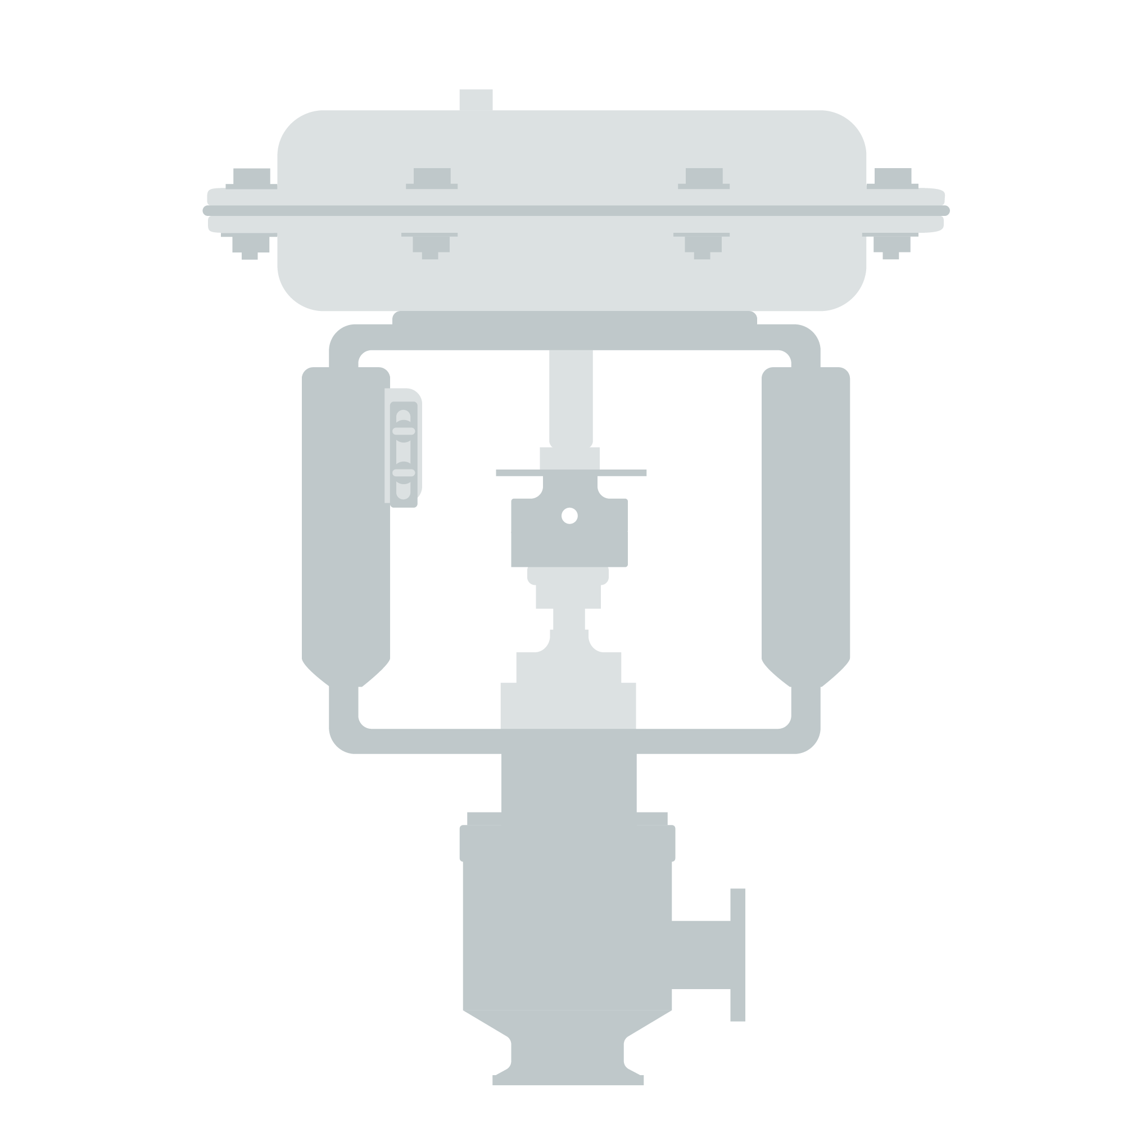

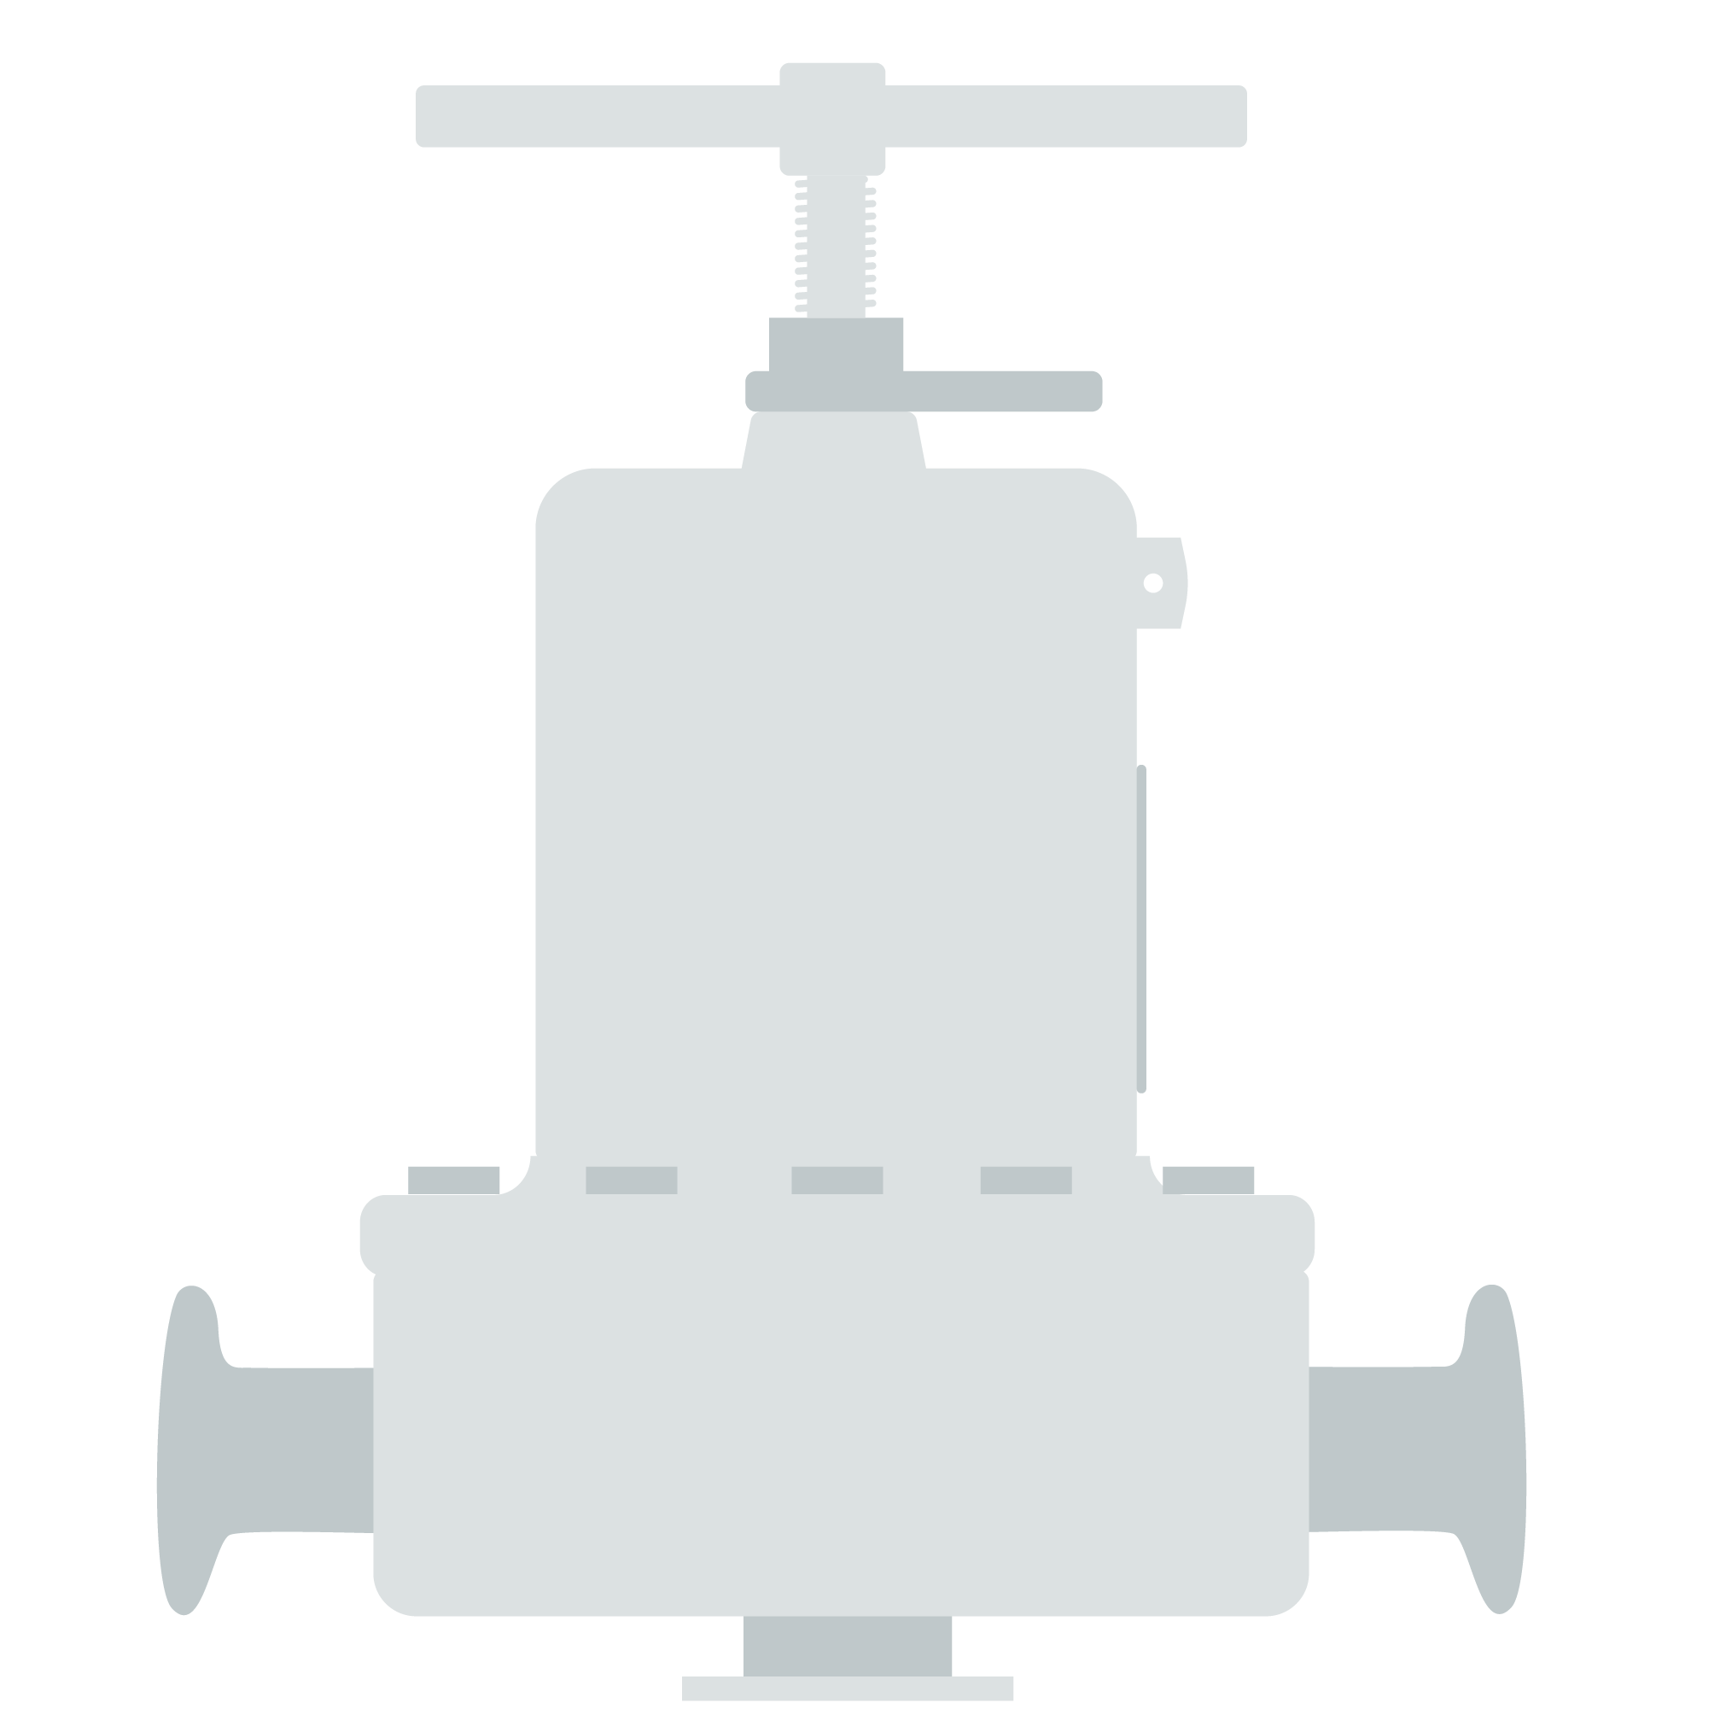
The
Jorlon
TM
Diaphragm

Slide 2
Guaranteed
for life
Aseptic and reliable valve components are extremely important in the pharmaceutical industry. And because they see the most wear, automated control valve and regulator valve diaphragms are particularly vital. Without a reliable diaphragm, the dependability of your aseptic process could be in serious jeopardy.

Slide 3
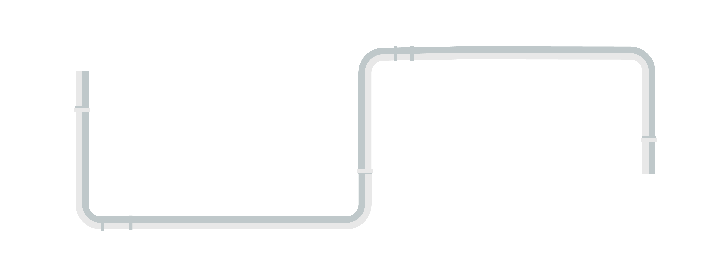
THE COST
OF FAILURE
Unscheduled shutdowns can result in 2 weeks to a month of downtime — no production!
A catastrophic diaphragm failure will distribute pieces of the diaphragm throughout the aseptic piping system to all points downstream of the valve, putting final drug substance quality at risk.
Depending on time of failure, valve location in the product train, and contaminant dispersion, the batch history must be audited to determine the extent of contamination over production time.
Drug batch(es) may be destroyed.
Complete processing systems must be shut down.
The extent of particulate contamination must be determined.
2-4
WEEKS
OF DOWNTIME

Slide 4

What can you do
to prevent this?
JorlonTM is a structurally modiﬁed, non-laminated, pure PTFE diaphragm material that provides a sterile barrier between the process and outside environment, and increases the life of your control valves and regulators.

Slide 5
change-out timeline
Conventional laminate diaphragms
3-12 months
Mark 978 JorlonTM Diaphragm
4 years*
0
1
2
3
4
YEARS
*Customer’s reliability engineer believes he can extend the change-out timeline to 7 years.

Slide 6

how it’s
made
PTFE is formed in a proprietary process to create a solid diaphragm. The product is thoroughly tested for durability, making sure you get the best results possible.
JorlonTM is warranted for a lifetime of use on:
Mark 95 BPRVs
Mark 95AA PBRVs
Mark 96 PRVs
Mark 96A PRVs
Mark 96AA PRVs
Mark 978 Control Valves
JSHM Hand Metering Valve
J-Series Gas Regulators

Slide 7
product applications
Final process fluids
Cryogenic liquids
Intermediates
Buffer
Clean steam
CIP fluid
Clean compressed air and gas
WFI

Slide 8

maintenance
JorlonTM reduces the need for excessive preventive maintenance.
A customer with a 200+ regulator population reported a
9-year period
without a single regulator maintenance event.

Slide 9

successfully tested
cycle testing
Successfully tested on a variety of Steriflow valves on 45 psig (3 bar) continuous steam service to over
1 million
full stroke cycles
1,200
JorlonTM has successfully tested nitrogen pressure to over
psi

Slide 10

successfully tested
lab testing
The valves were successfully tested with an additional
100
steam & vacuum cycles
Lab tests comparing JorlonTM to 316L diaphragms show continued life after exceeding the SST failure cycle count by more than
100
X

Slide 11



Tens of thousands
of Steriflow valves with JorlonTM Diaphragms have been installed in FDA-approved systems and facilities.

Slide 12

FDA compliant
USP certified
ADI/TSE free
Incredibly dependable
Lasting years longer than laminated diaphragms

Slide 13

With a
Jorlon
TM
Diaphragm
you can…
1
Save money
2
Extend preventive maintenance diaphragm change-out times
3
Realize the benefits of a regulator and control valve that outlasts most normal systems

Slide 14
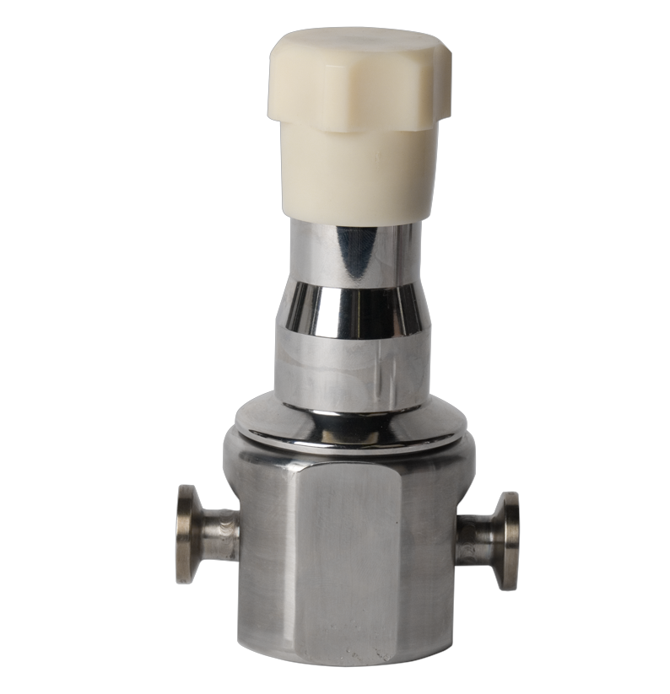
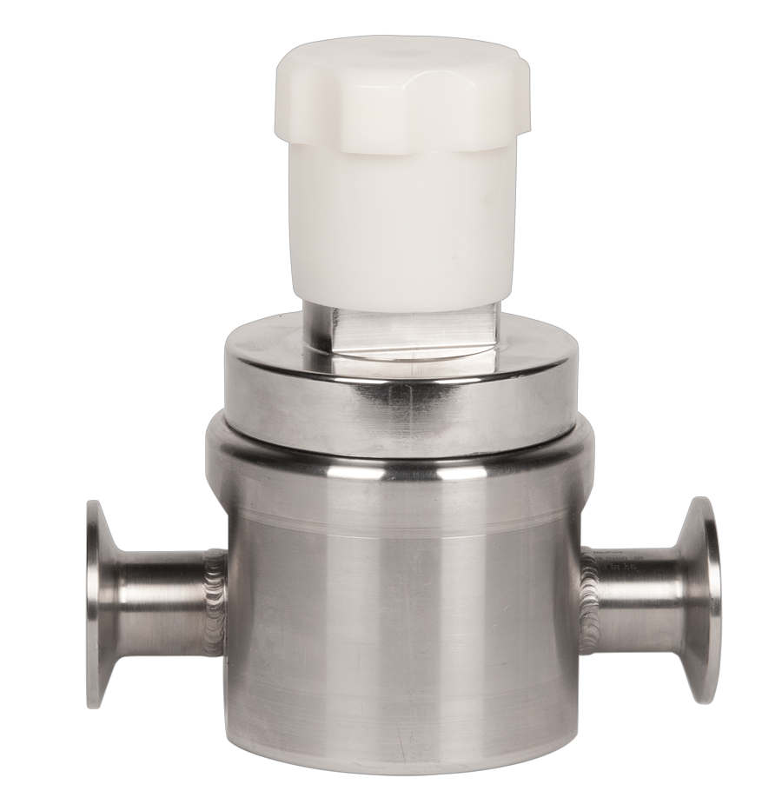
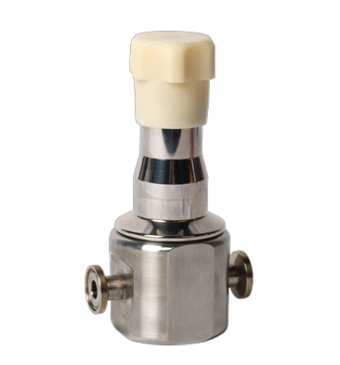
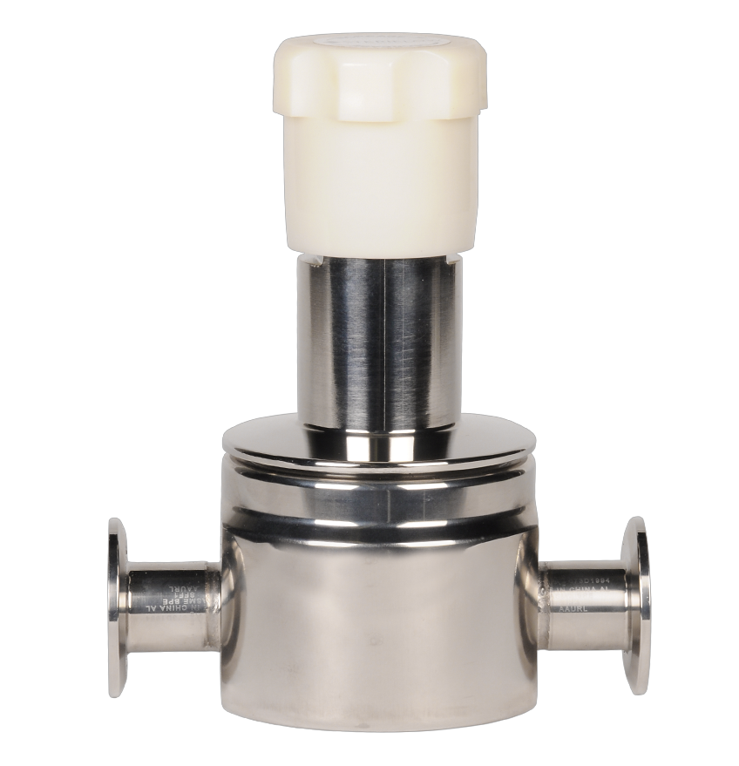
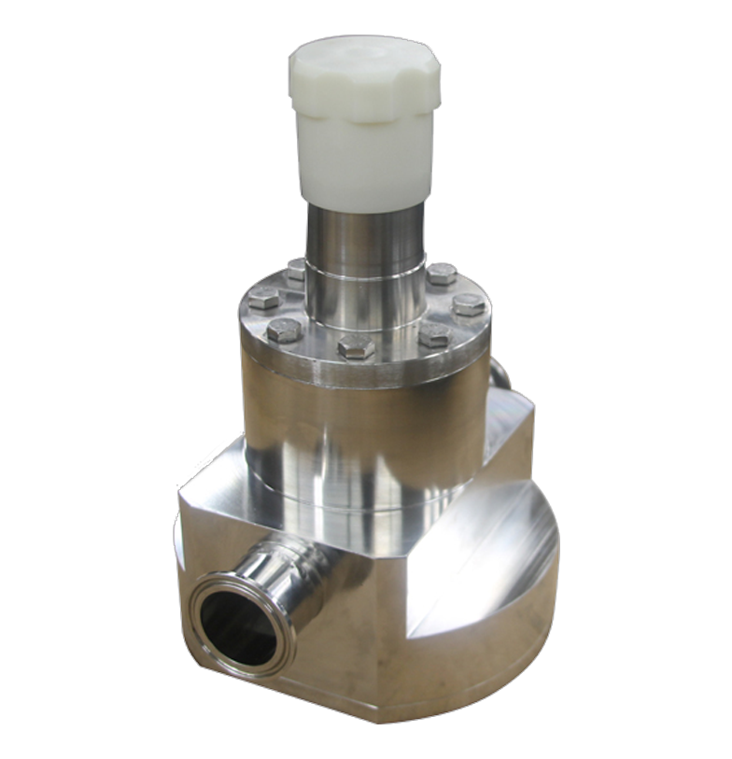
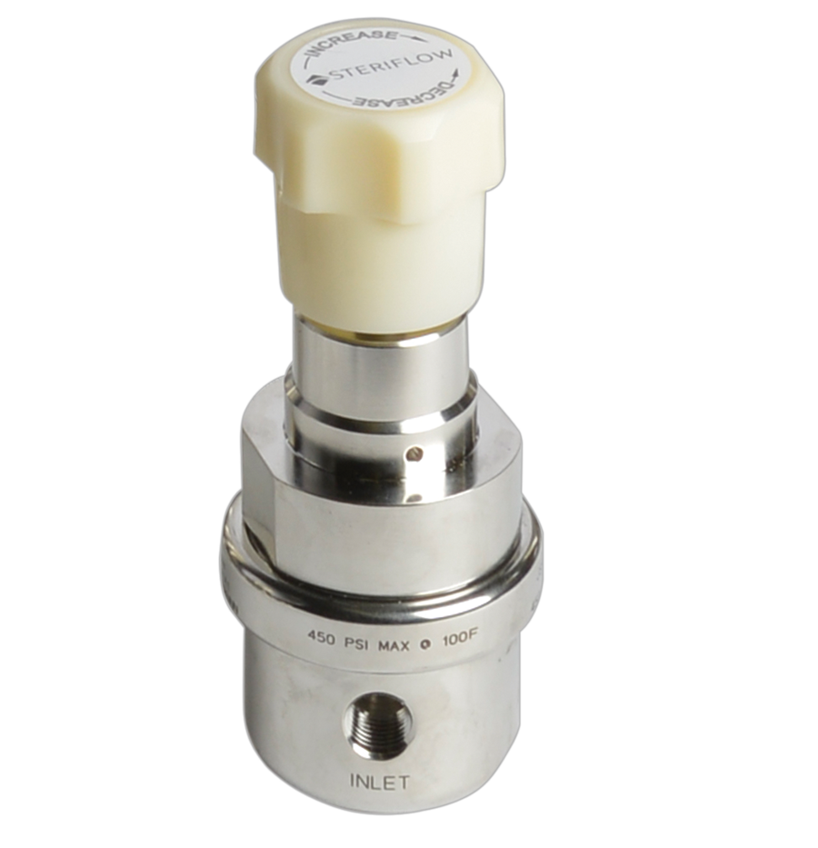
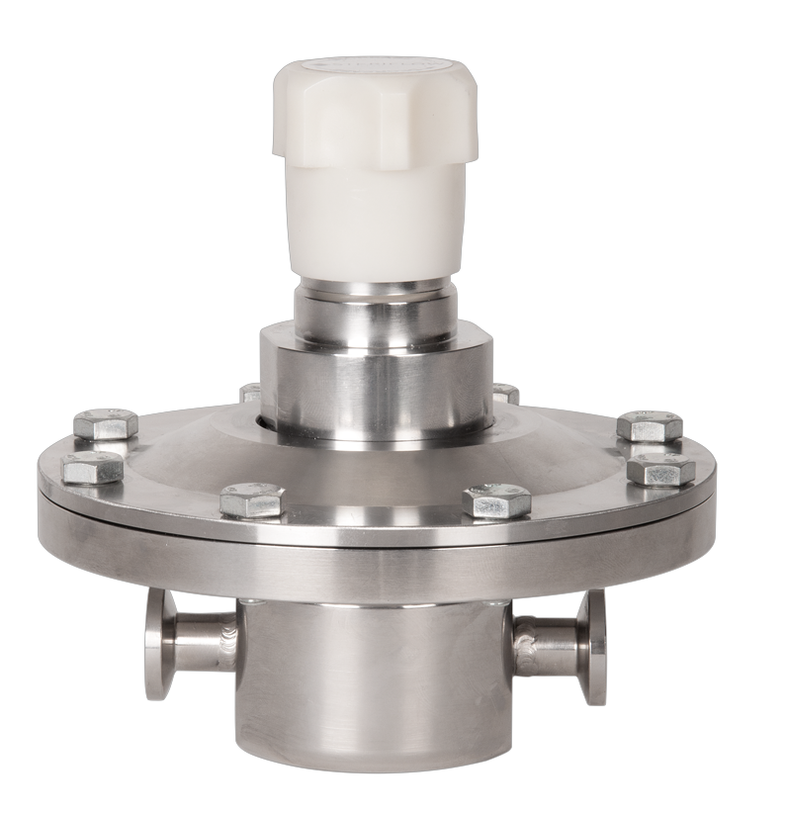
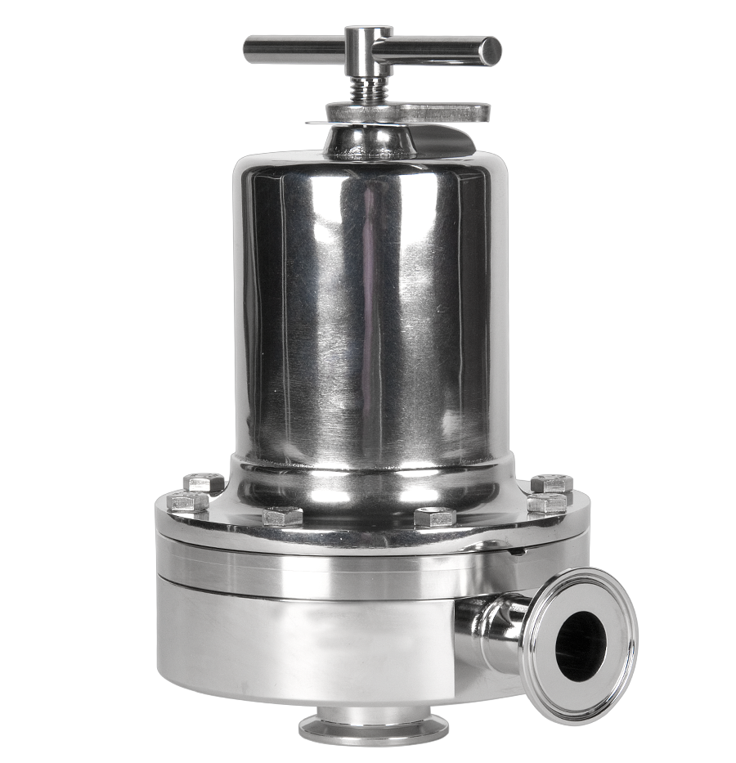
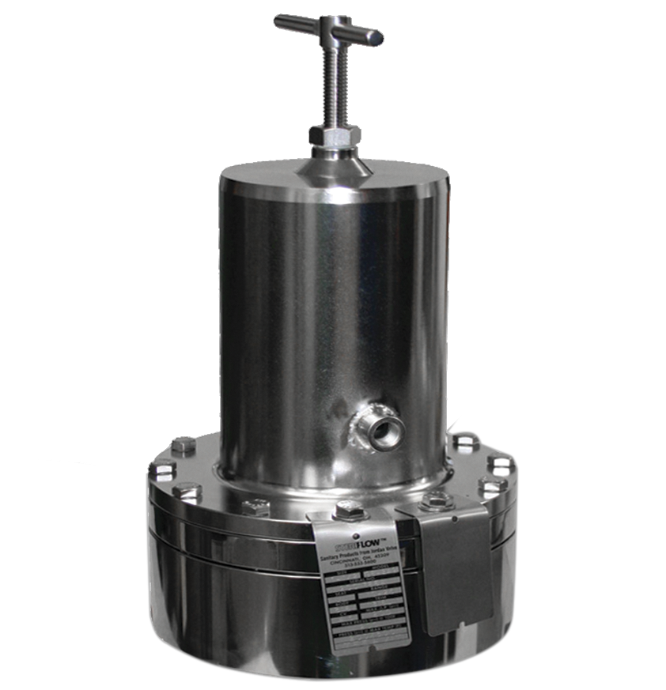
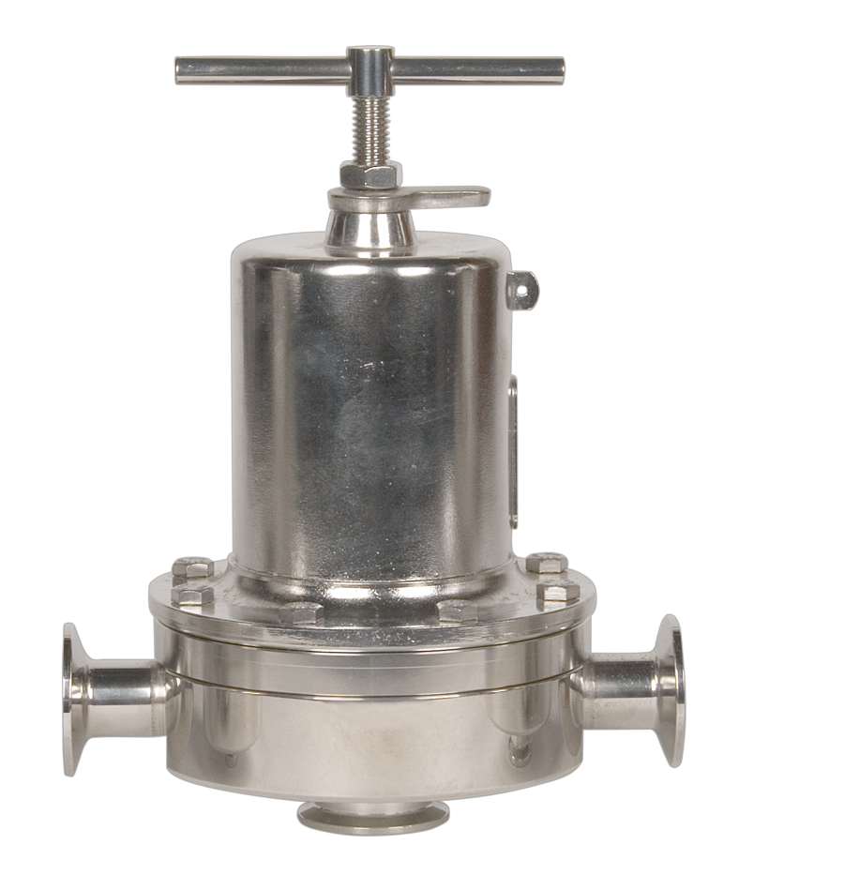
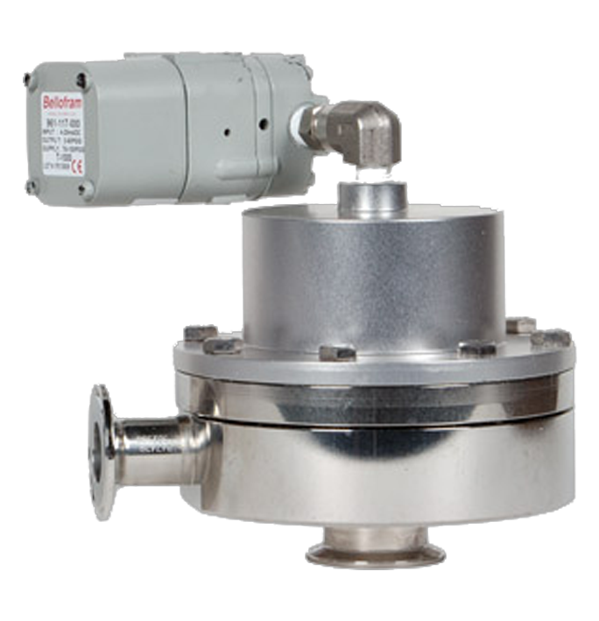
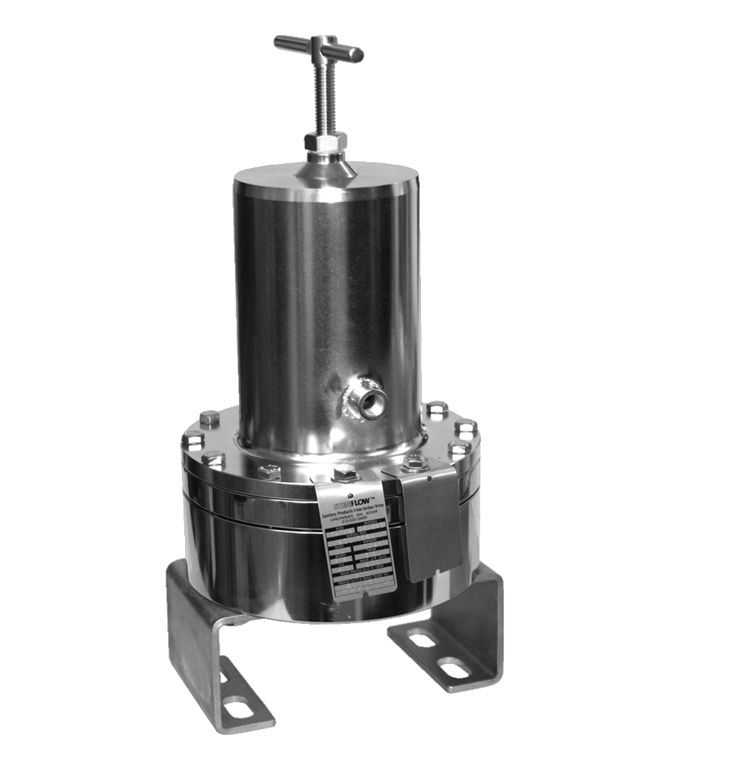
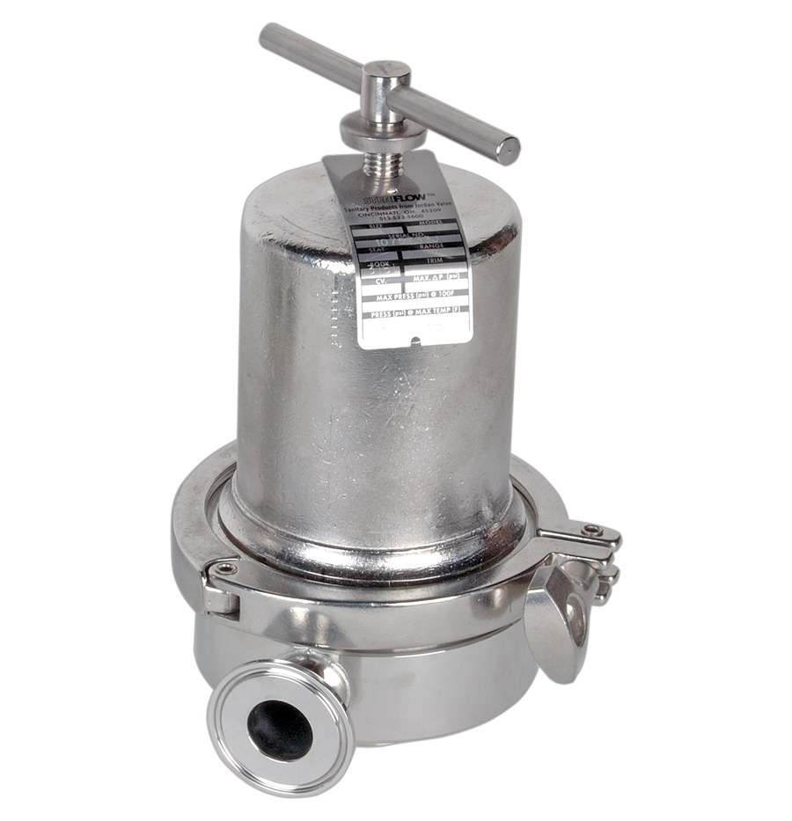
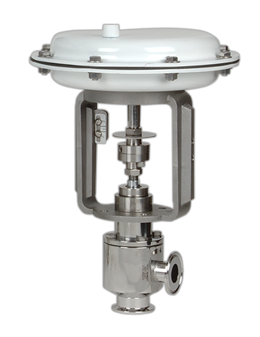
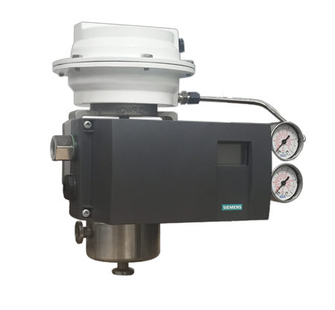
JorlonTM
Diaphragm
valves
JSB Series
JSHM Series
JSR Series
JSRH Series
JSRHF Series
JSRLF Series
JSRFLP Series
Mark 95 Series
Mark 95AA Series
Mark 95FT Series
Mark 96 Series
Mark 96A Series
Mark 96AA Series
Mark 96C Series
Mark 978 Series
Mark 978LFJD Series

Slide 15


check us out on social media
@steriflowvalve
steriflow valve
steriflow valve

Slide 16

www.steriflowvalve.com
513-533-5600
check out our blog on our site!

